Slide 1



South Manchester
Macmillan Information & Support Services

Slide 2
Breast Cancer – Breast Services
Bowel Cancer – Colorectal Surgery
Skin Cancer – Dermatology, Plastic Surgery
Cervical , Ovarian, Womb, Vulval/Genital and Vaginal Cancer – Gynaecology
Leukaemia, Lymphoma and Myeloma – Haematology
Head and Neck Cancer – ENT/Head and Neck Services
Lung Cancer – Cardiothoracic Surgery, Thoracic Oncology
Oesophagus / Stomach Cancer – General Surgery
Bladder, Kidney, Prostate, Penis, Testicle and Adrenal Cancer – Urology
Every year we receive around 8,500 GP referrals for suspected cancer and around 2,300 patients with newly diagnosed cancers are treated at MFT every year.

Slide 3
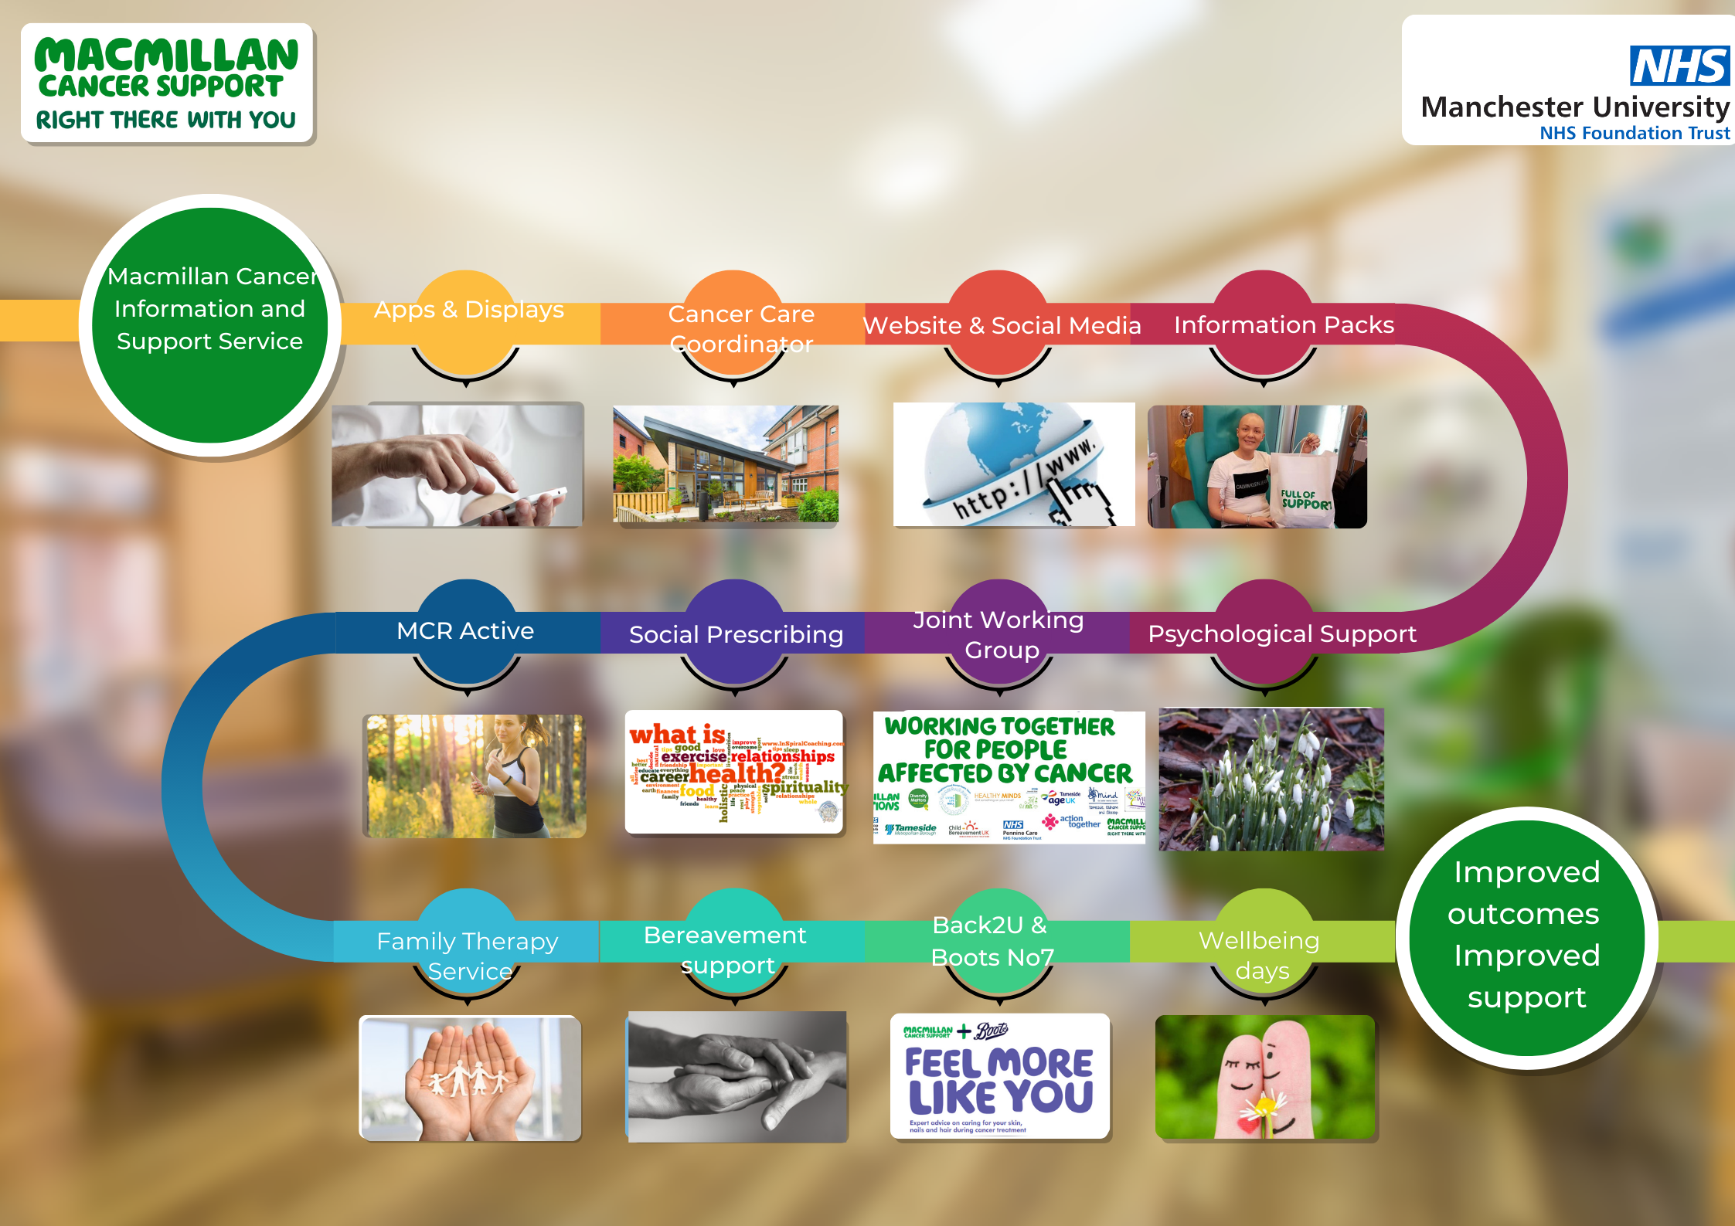


Slide 4


Macmillan Information and support services
Provide a point of contact for people affected by cancer.
Experienced team offering Face to face, telephone & online support.
Availability of cancer information and support.
Gardening group and great outdoor space
Great environment
Access to emotional & mental health support services
Complementary therapy
Bespoke setting for Support groups, meetings and Activities
Volunteer engagement and support in the hospital & across the community
Opportunities for feedback & meaningful service user involvement

Slide 5


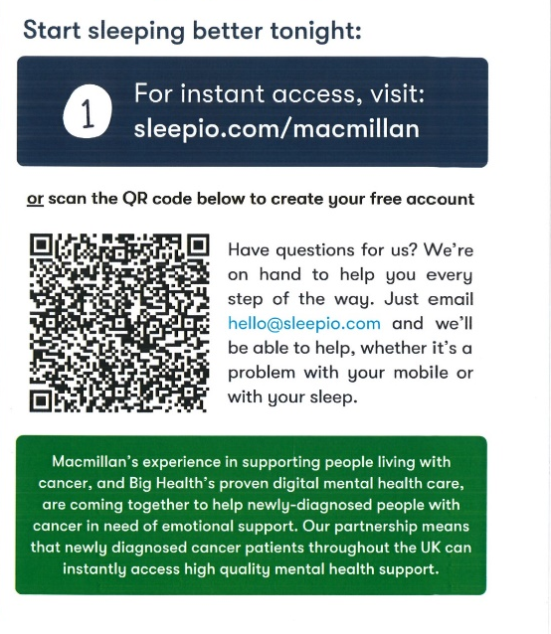

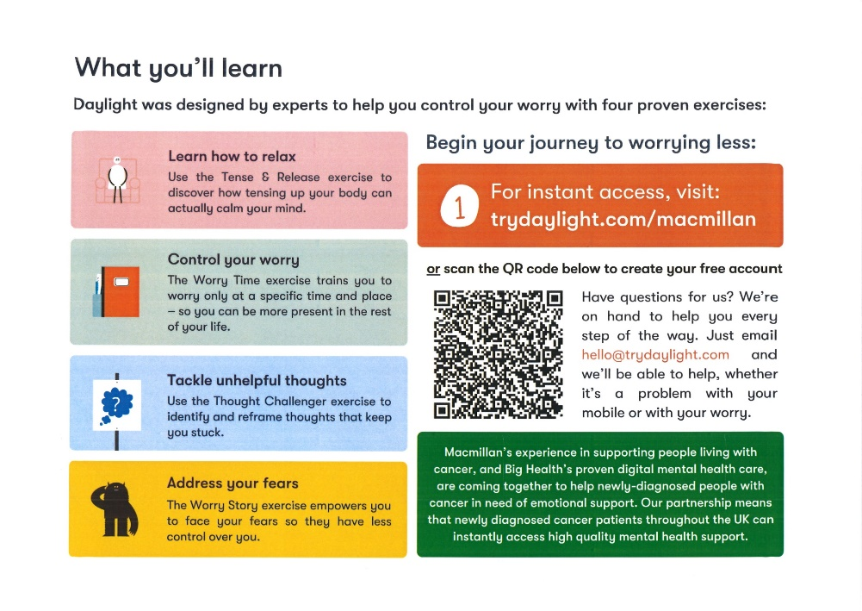
Living Displays
Notes:
Living Displays
Check & map information points and displays.
Consider displays across community & PCN
Adapted displays for places of worship
Standard Leaflet and booklet availability.
Use noticeboards to create displays with QR codes
QR Codes linking to apps
QR Codes linking to leaflets

Slide 6
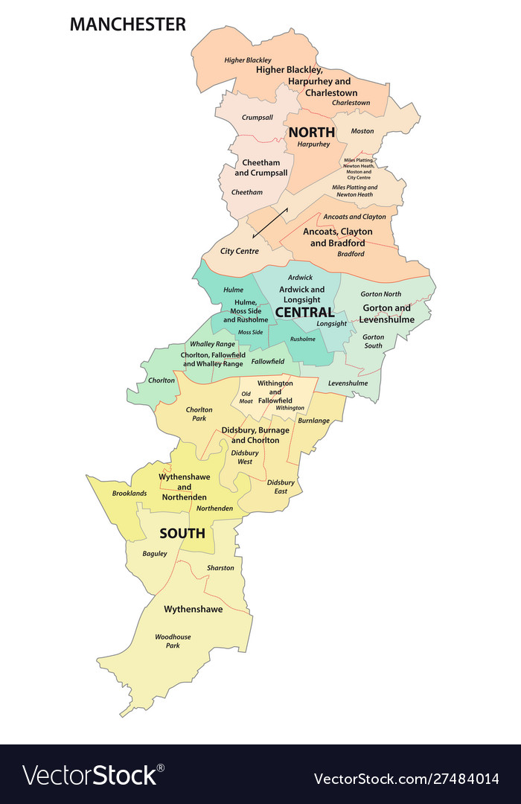
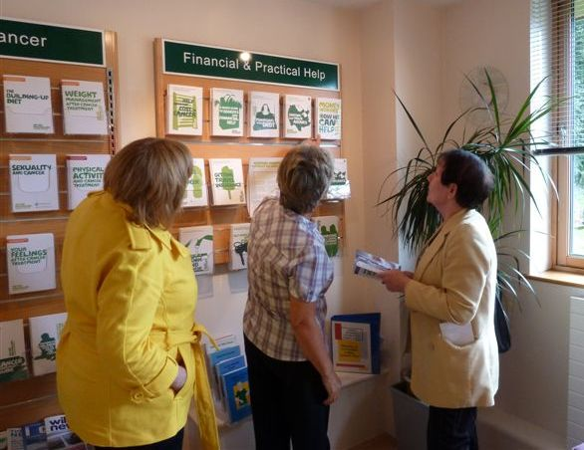
Trafford Wellbeing college
PCN network
Cancer Champions
Practice Champions
Cancer care coordinators
Community opportunities
Outreach

Slide 7
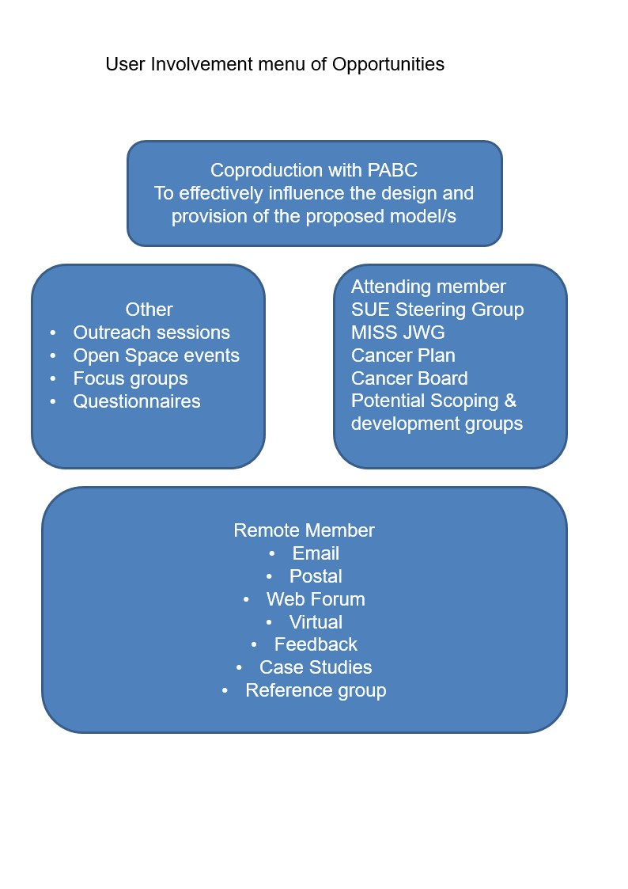
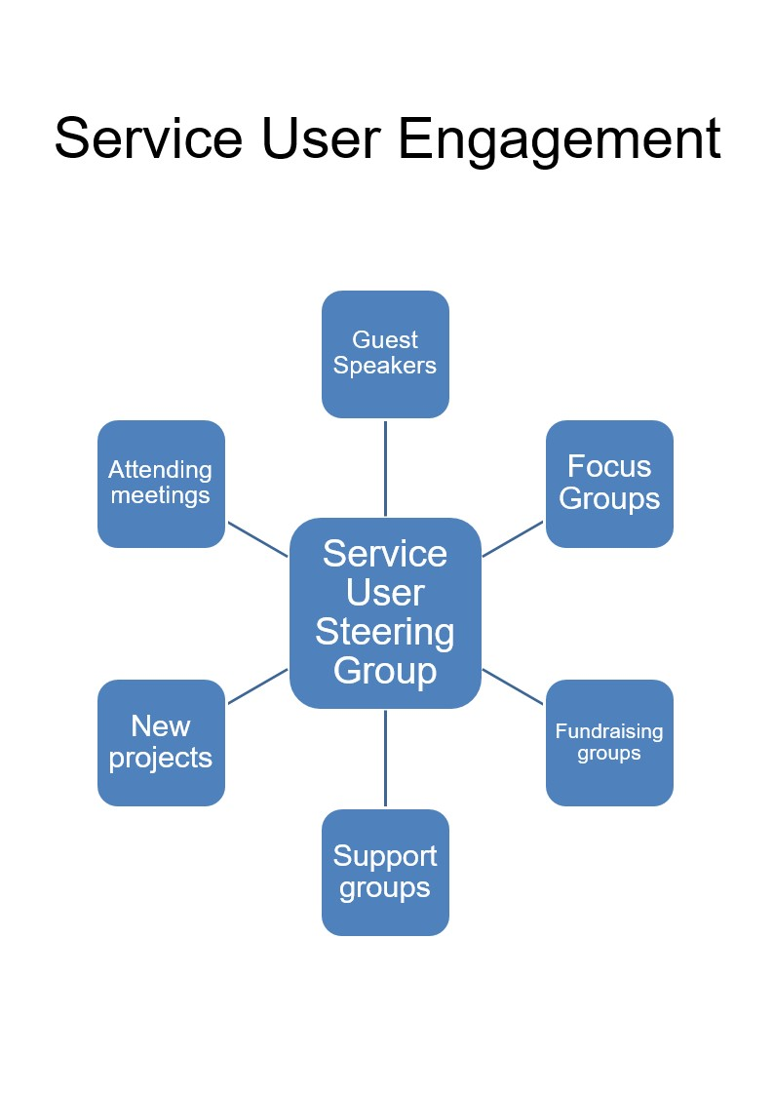
Lived Experience
Notes:
Setting up a Service User Engagement Steering Group. PABC being invited to join the bi monthly Steering Group.
The group made up of people with lived experience supported by the Service user engagement lead & Macmillan user engagement facilitator. The group will take an increasing degree of control of the direction of service user engagement. Facilitation & administrative support will be provided. As the Steering group develops it will be responsible for setting up new projects and groups, which report & feedback to the steering group.

Slide 8
GM CANCER EARLY DIAGNOSIS & INNOVATION 2023-24/5 EXPRESSION OF INTEREST
GM Cancer Psychological care & wellbeing pathway board
GM Cancer health and Wellbeing information and support pathway board
GM Cancer Mayoral project board

Slide 9

Feedback

Slide 10
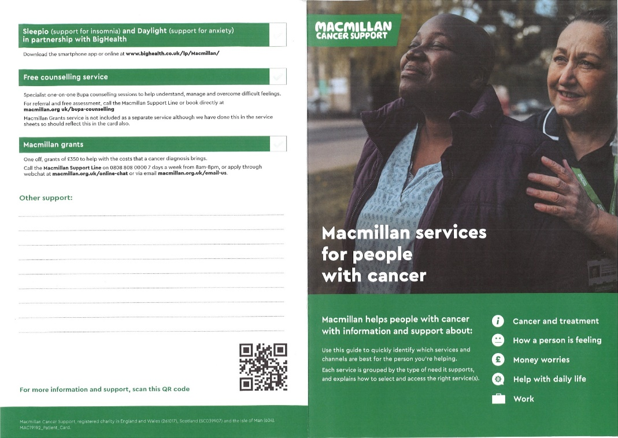
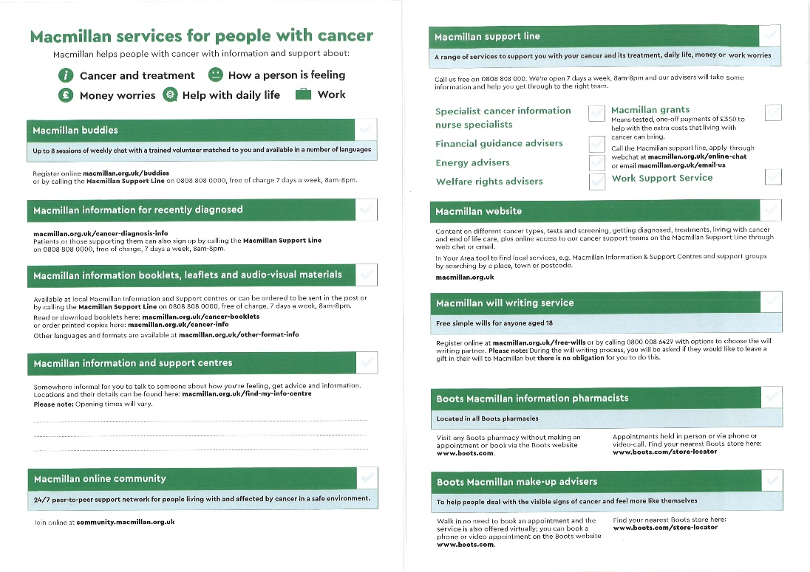

Slide 11
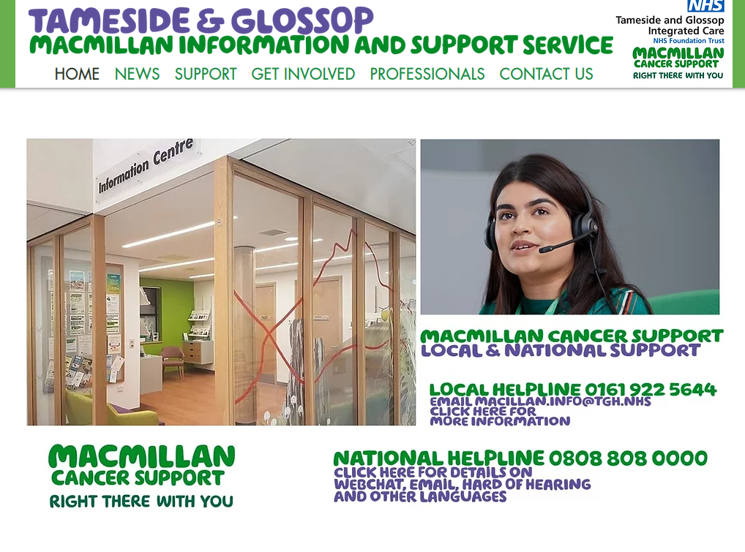
The service has created a website which has had over 15000 site visits, 8000 unique visitors and over 40,000 page views.
The service has improved clarity and ease of access for people looking for support and people interested in service user involvement or volunteering locally.
Digital services
tamesidemacmillan.org

Slide 12
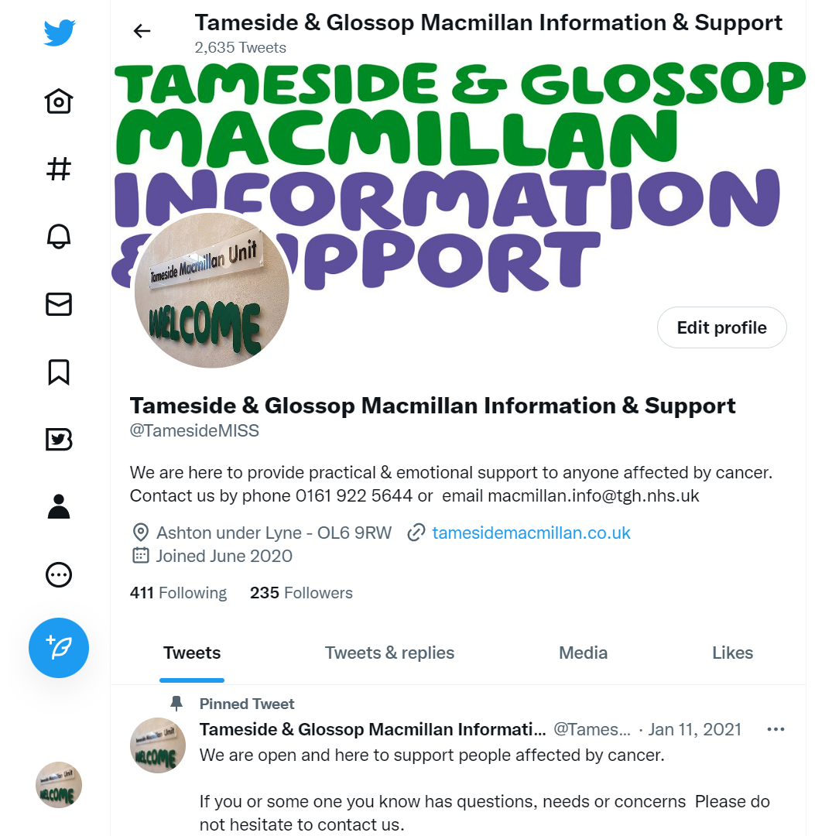
The service created a twitter account with the aim of helping to promote access to the service through lock down. Highlighting local and national support
Whilst continuing to promote local and national support we now also work to magnify the reach of our service and other services support as hospital and community cancer care coordinators and stakeholders form the local Cancer joint working group.
Linkedin
Whilst Twitter is used to reach people affected by cancer to help promote opportunities for support, Macmillan Information team members use their Linkedin accounts to promote local success stories, innovation and collaboration across professionals and key stakeholders
Twitter
@TamesideMISS
www.linkedin.com/in/david-banks-b51559112
linkedin.com/in/tania-armstrong-16b32b23b

Slide 13
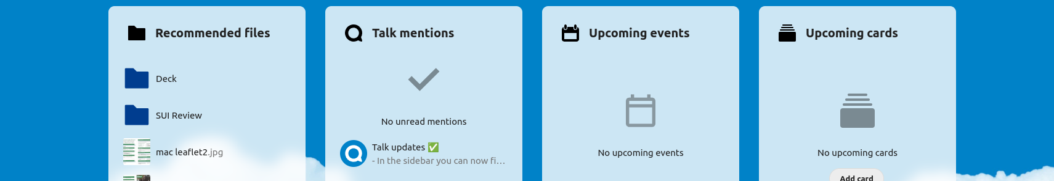
Online Platform
One login -
immediate secure access
Designed to be as easy to access entry point to meaningful collaboration, feedback and the sharing of information and ideas

Slide 14
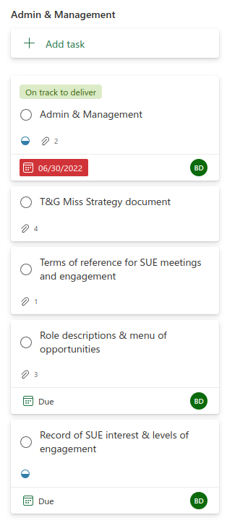
Completed
Terms of reference completed
Strategy/vision document completed
Promotional Material – Available Paper, Pdf and online
Person with lived experience attending cancer plan steering group
Engage with Macmillan Regional Team
Jodie Taylor Macmillan regional Service user Involvement Lead
Greater Manchester Mayoral project
Elizabeth Rouski Macmillan Central publications
Role Descriptions & Menu or opportunities
Process in place to recording interest and levels of engagement
Initial Meeting completed
All the above to be looked at in stages with a view to oversight and co production at Lived experience group meeting

Slide 15
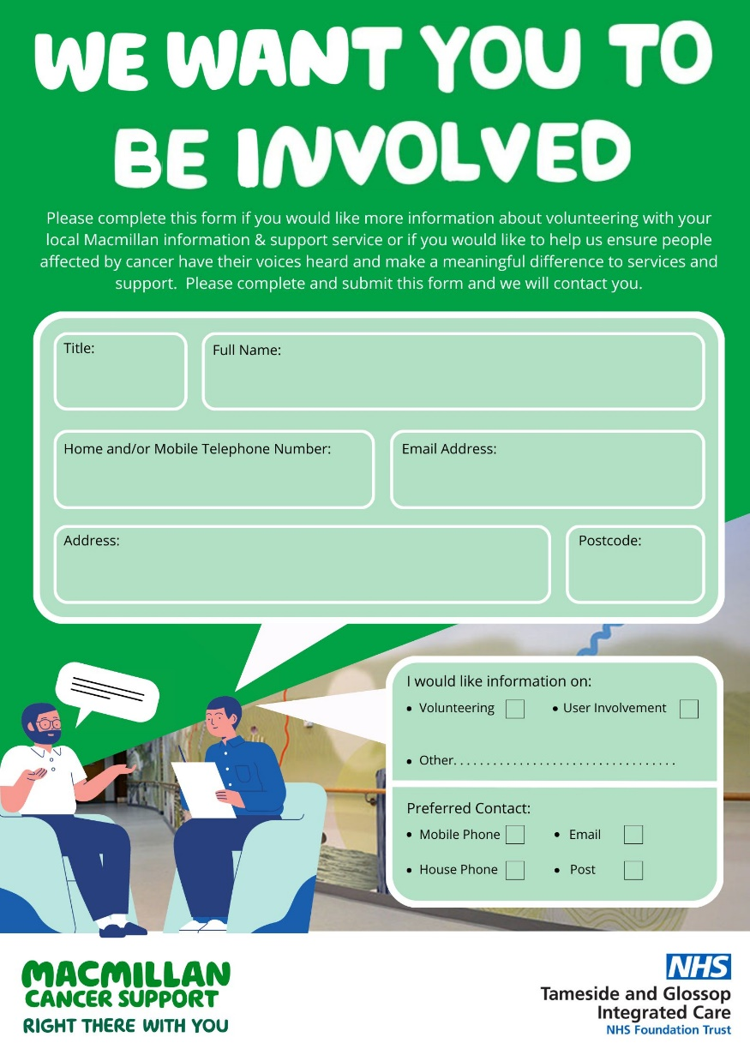

Service user or volunteer opportunities promotion
Paper form created to register interest and invite contact.
This is accompanied by online offer
https://www.tamesidemacmillan.org/volunteering

Slide 16
Better shared use of volunteers
Macmillan Community
Volunteers
Hospital Volunteer service
BAME community Volunteers
Macmillan Information and support services
Hospice
Volunteer Service
Other community
Be Well

Slide 17
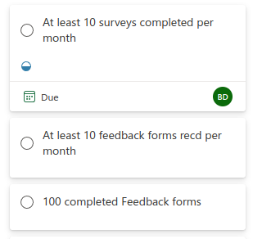
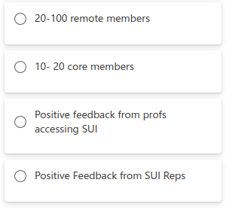
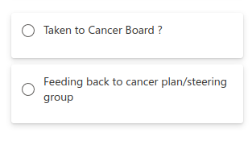
Measuring Outcomes
Reporting

Slide 18
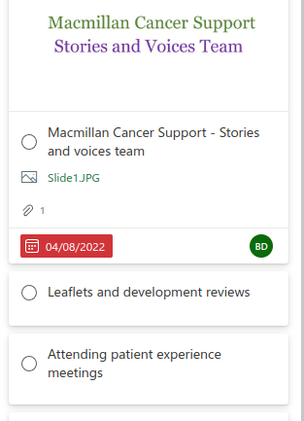
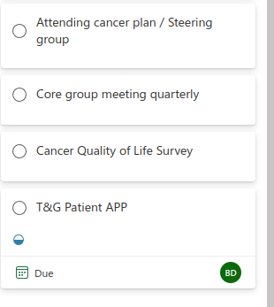
Activities

Slide 19
Macmillan Volunteer
Travel & Community support
Assessment by phone or at home depending on issue, need or concern
Identify appropriate volunteer offer of support
Social prescriber assessment
and referral
Link in with Partners including community and support groups
T&G Macmillan Information and support service
Signposting & referrals to other as appropriate including community and support groups
On site services & support
Emotional and Mental health support
Psychological wellbeing assessment
Financial Advice & Support
Complementary therapies
MCRactive
Exercise Advice & Support
Macmillan Support group
Benefit check support to claim benefits
Willow Wood
Start Clinic
Further support in the community
Macmillan nurses
Offer of treatment or support
Debt Advice and Support
Walking Groups
Gym & Community centres
Counselling Service
Employment Advice & Support

Slide 20
Macmillan HOPE course
Macmillan Cancer Support
GM ICP
Trust
Emotional Support Specialised Treatments
Volunteer Benefit Advice service
Hospice services and Clinics
Local Macmillan Benefits Advice
Patient Neighbourhood Groups
Healthy Minds Emotional Support Service
Complementary Therapy Service
Cancer Champions
GP Training
Events
Community
Macmillan Volunteer counselling service
Macmillan Information and Support
GP neighbourhood meetings
Manchester Council
Community Support Services
Partnership engagement network
Souith Manchester Colleges
MCRactive
Exercise support & advice
Macmillan Support group
Diversity Matters
Wigs & Hairdressing
Manchester Council Social marketing Team
MCRactive
In the community
Support groups
Manchester Prevention and early detection Group
Be Well
Social prescribing
Volunteer Bureau
Other community

Slide 21
Onsite services
Macmillan Volunteer counselling service
Macmillan Welfare Rights
Emotional Support Service
Complementary Therapy Service
Macmillan Information and Support
Bereavement Support
Community Support Service
MCRactive
Exercise support & advice
Macmillan Support group

Slide 22


The Joint working group meets quarterly.
Its remit is to improve support for people affected by cancer through integrated joint working.
Working together on a shared online action plan towards agreed targets and goals. Strengthening and expanding existing support, identifying gaps in support and creating new provision to close the gaps.
Collaboration & Joint working
The Macmillan Joint Working Group
The joint working group comprises of our lead cancer nurse, Macmillan GP, Cancer services commissioner, Trusts senior service and business planning manager, 2 lead Clinical nurse specialists, Heathy minds, TOG MIND, Age uk, Neighbourhood mental health team Willow Wood, Child Bereavement UK, Action Together, Disability employment advisors Job centre plus, Macmillan Welfare rights officer Tameside Council, Macmillan Solutions, and Diversity Matters NW (BAME community)
Notes:
Social prescribing
Practice cancer champions
MCRactive
community Groups

Slide 23


Tameside & Glossop Macmillan
Joint working Group - Actions
Palliative Care Well-being & Psychological Support
Map appropriate national and local services
Identify gaps in support and propose solutions
Agree a palliative care counselling and support Pathway / network
Curative intent -
Psychological Support and Holistic well-being
Working with relevant stakeholders identify a robust pathway into psychological support for people affected by cancer
Digital support
Clear points of access for digital information, online directories, tools and support for people affected by cancer and health care professionals Online offer creation of new or identification of existing support streams which can be offered by phone, Online, face to face or in some cases choice of all three. Better promoted to PABC and Clinicians Including online support groups, videos and message boards.
General Practice – Primary Care
Build links and create the facility to take referrals directly from primary care services to Macmillan information and support increasing access to support
Community Cancer Champions
Physical activity & diet
Self Image, mental & physical
Social prescribing for cancer
Multi-faith, ethnicity, awareness & support
Promotion & Awareness
Creation of an easy to access network to reliably and repeatedly promote available services for People affected by cancer

Slide 24
Tameside Macmillan Welfare Rights

Slide 25
Microsoft teams –
Kanban & agile – online dynamic action plans
Future bespoke platform
25

Slide 26
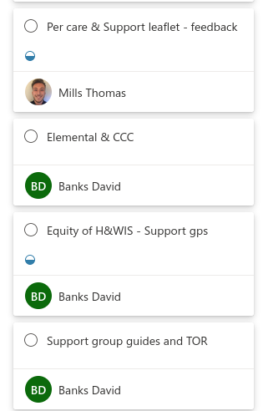
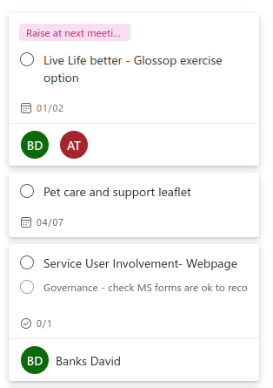
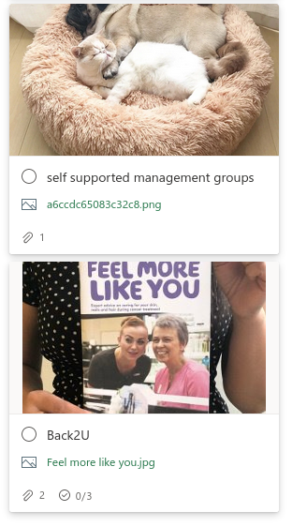
New & Incoming

Slide 27
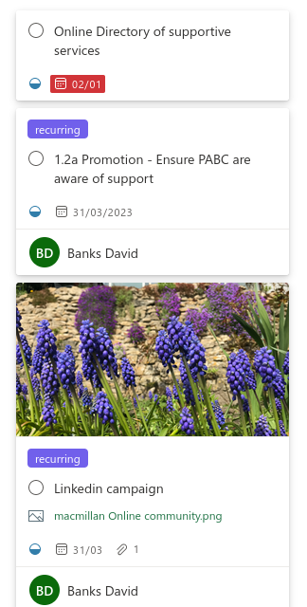
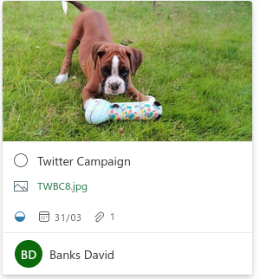
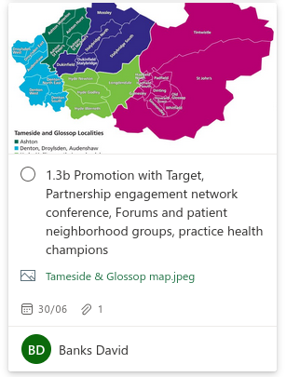
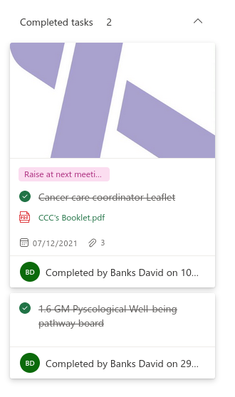
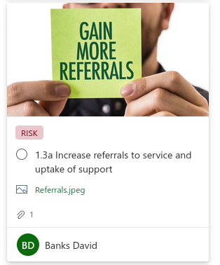
Shared Objectives

Slide 28
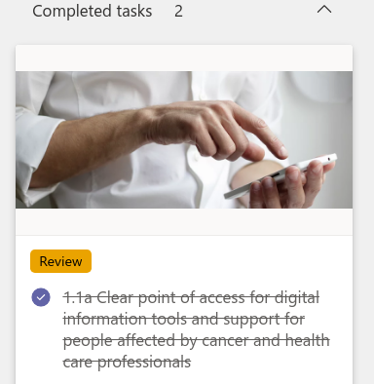
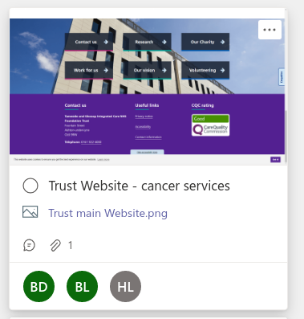


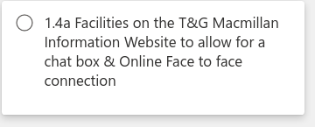
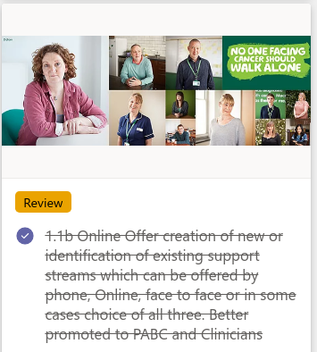
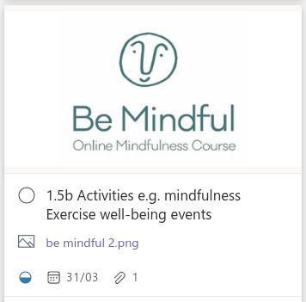
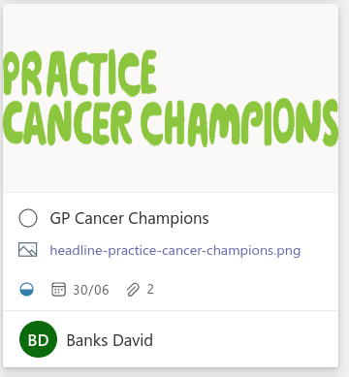
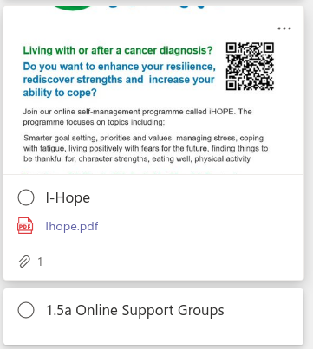
Digital Services & Support

Slide 29

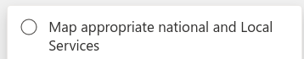
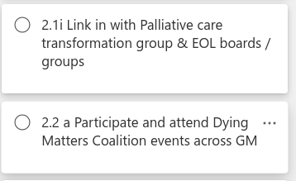
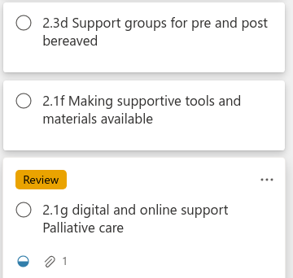
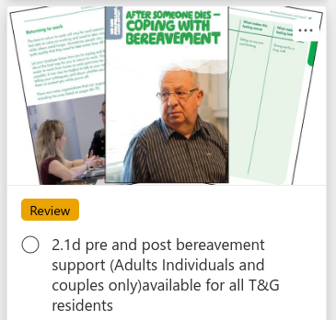
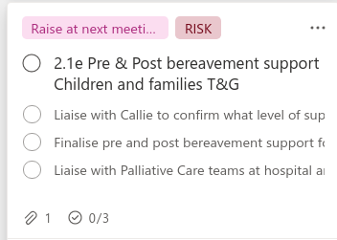
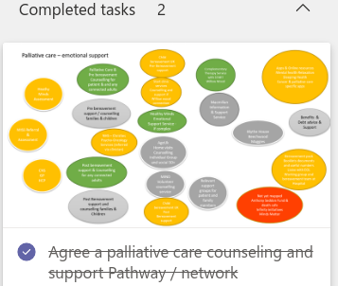

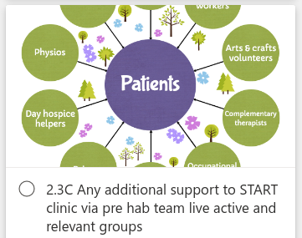
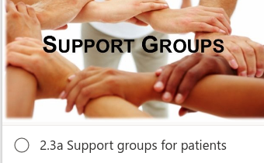
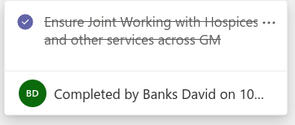

Palliative care Well-being & Psychological support

Slide 30
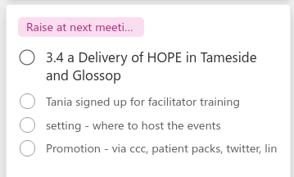
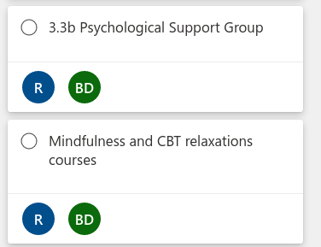
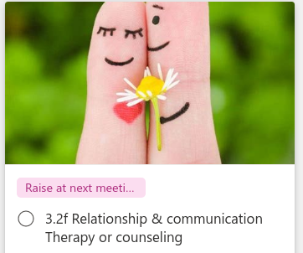
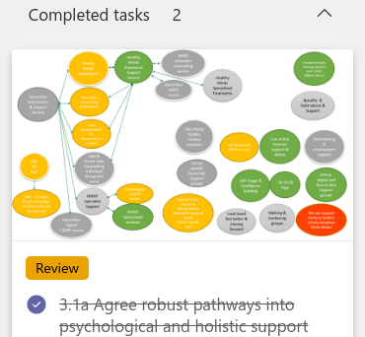
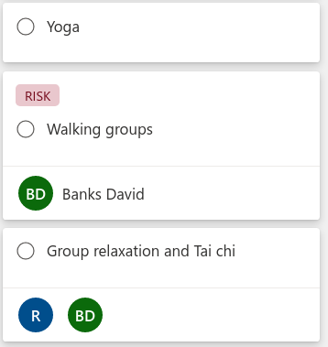

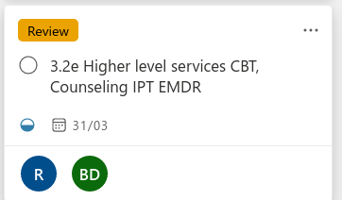
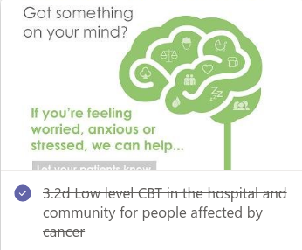


Curative Intent Well-being & Psychological Support

Slide 31





Outreach
Social Prescribing & Elemental

Slide 32

Patient, Friends & Family Packs

Slide 33









Feedback & Service User Involvement
Promotion
Campaigns & Resources
Admin & Management
SUI Activities
Network
Measuring outcomes
Reporting

Slide 34


Slide 35


Slide 36

The Dashboard

Slide 37

Files

Slide 38

Calendar

Slide 39

Deck – Kanban action plan

Slide 40

Talk – Video, Audio and text chat and sharing

Slide 41
Maps – Map creation & link sharing

Slide 42

Canva & Microsoft Forms

Slide 43

More people are thankfully living longer following a cancer diagnosis through successful treatments and advances maintaining or managing a cancer condition.
The numbers of people living long term with a cancer diagnosis are set to double by 2030. Having access to social prescribing means people can access community support as well as specialised cancer services.
Social prescribing & Elemental
Software platform to facilitate and support social prescribing. It is a referral and case management system with direct connections to GP IT systems. Joining Elemental as a hub has vastly increased visibility and ease of access to Macmillan information and support service to GP`s locally.
This approach has facilitated joint working and integration with social prescribing teams and local services. It has also kept Macmillan Quality information and support services high on the agenda and benefiting from the momentum of the social prescribing movement.

Slide 44
Macmillan Information and Support Services
Hospital
Cancer Care Coordinators
Personalised
Care
Macmillan Tameside joint working Group
PCN
Cancer Care Coordinators

Slide 45
Personalised Care – Shared Activities & involvement
Add items – Items could be identified as part of team building
Initial contact
Materials
Support Groups
Materials
Health & Well-being events
Facilitate holistic activities
HOPE Course
Materials
Awareness campaigns
Social Media
Personalised care agenda
Macmillan & GM events

